Slide 1

DEFECT PROGRAMMER ASSIGNMENT
CAPGEMINI SPRINT -1 GROUP 3

Slide 2





THE PROJECT IDEA
To develop a software that automatically assigns the defects reported by the client company to programmers depending on the functional area they are handling.

Slide 3
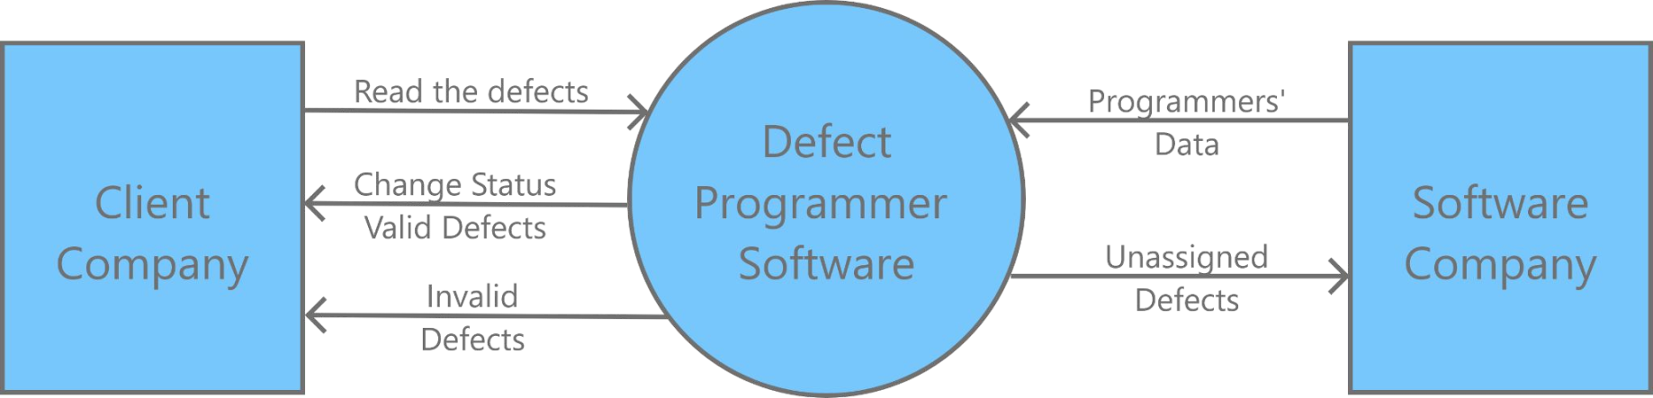
Our Solution

Slide 4



REQUIREMENTS
Multi threading
Dynamic memory allocation
File input output handling
Data structures(Array)
Make file
Valgrind
CUnit

Slide 5
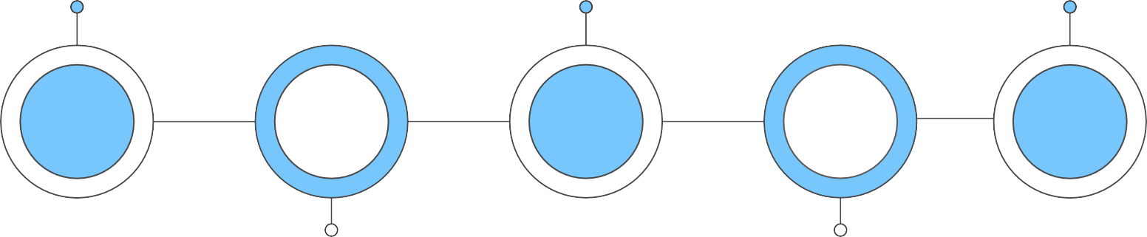
Program Flow
Multiple Defect Files
Employee Database
Unassigned Defect
Invalid Defect Multiple Employee Assignment
Input Files
getdefect.c
Output Files
1
2
3
4
5
main.c
assign.c

Slide 6
01
main.c

Slide 7
STRUCTURES
01
Defect
02
Employee
Struct defect{ Char *defectID; Char *description;
Char *moduleName; Char *functionalArea; Char *date;
Char *status; Char *type;
};
Struct employee{ Char *Id;
Char *Name; Char *BUnit; Char *Expertise;
Char *Designation; Pthread_mutex_t emplock; Int n_defect;
Defect *assigned_arr[MAX];
};

Slide 8

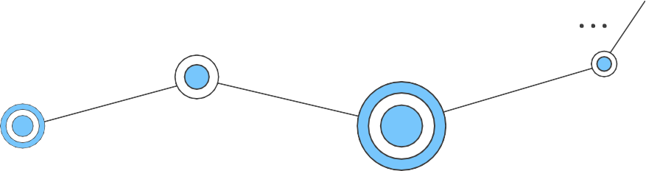
1.main()
Input Defect ﬁles are taken as command line arguments and also validates them.
Separate threads are created for each input ﬁles and these ﬁles are passed to getDefect() Function.
It calls getEmployee() function to fetch data from Employee Database.
Finally it waits for all threads to complete their work
.

Slide 9

2. getEmployee()
It opens “employee.txt” database ﬁle.
Now it reads the ﬁle line by line, each line contains information of one employee.
It stores this information inside Employee Structure.
Displays error if ﬁle can't be opened for any reason.

Slide 10
02
02
getdefect.c
getdefect.c

Slide 11
Functions
1 . Get Defect
Reads defects from the input and and calls checkvalidity and call assignEmployee for valid defect
3. Valid defect
It stores the valid defect in Defect structure
2. Check Validity
Returns true if count is equal to 7 and else return false
4. Invalid Defect
Display invalid defect message and append it into invalidDefect.txt

Slide 12
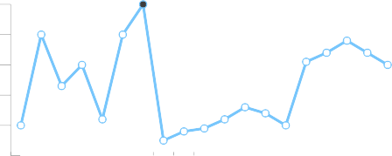


1.GetDefect ()
It reads defects from the input ﬁle
Calls checkvalidity if true call validDefect() Else call invaliddefect()
It calls assignEmployee() for valid defect

Slide 13



2. CheckValidity()
We initialize count = 0;
It divides the string into token using strtok And increment count for each attribute
: is delimiter
char *token = strtok(s, ":");
If count is equal to 7 , it returns true Else returns false

Slide 14

3. ValidDefect()
It tokenizes the string using strtok with And dynamically allocates memory and stores them into their respective Attribute in defect structure.

Slide 15


4. InvalidDefect()
It display invalid defect message with defect id and appends it into invalidDefect.txt

Slide 16
03
assign.c

Slide 17
Functions
01
03
02
04
assignEmployee()
Checks for defects with status as open.
searchProgrammer()
Searches for programmer suitable of open defect.
unassignedDefect()
Copies all unassigned Defect into separate text ﬁle.
createEmployeeFile()
Creates separate ﬁles for each programmer who have at least one defect assigned to him

Slide 18

1. assignEmployee()
It loops through all defects and checks their status.
If status is open then it calls searchProgrammer() Function.
Defects with any other status are ignored.

Slide 19

2. searchProgrammer()
Now for each defect passed, it searches for programmer in the array.
Search Criteria:
Functional Area of Defect shall match with Expertise of Programmer.
If there is a match, the defect is assigned to the programmer and createEmployeeFile() Function is called.
If no programmer could be found then uassignedDefect() Function is called for that defect.

Slide 20

3. Unassigned Defect()
Now it opens “unassignedDefect.txt” ﬁle and appends all information of current defect to the last line of the ﬁle.
If ﬁle is not present it creates a new one.
Displays proper error if there is any issue with opening or writing inside this ﬁle.

Slide 21

4. Create Employee File()
Creates separate ﬁle for each employee, if not present already, who have at least one defect assigned to them.
Filename: <EmpID>_assignments.txt
Appends employee and defect information into the ﬁle.
Displays proper error if there is any issue with opening or closing of employee ﬁle.

Slide 22
Testing
Unit testing and Integration testing

Slide 23
Files
Defect.txt
defectID : description : moduleName : Functional Area : date : status : type
F001:Column values in BOM reports are incorrect:Aircraft design:BOM reports:21/08/2022:open:fatal
F002:Unit prices are not shown while preparing invoice:Invoices:Display products:23/04/2022:close:fatal
N001:BOM report columns not aligned properly:Aircraft design:BOM reports:21/08/2022:open:niceToHave
O001:Aircraft:BOM reports:21/08/2022:open:niceToHave
F003:Column values in client dashboard not shown:Aircraft design:Manage customers:21/08/2022:open:fatal
Employee.txt
employeeID : Name : Business Unit : Expertise : Designation
A123:Suresh Panchal:UK Telecom:BOM report:Principal engineer
D012:J K Laxmi:Finacle Systems:Display products:Junior programmer
C015:Sandeep Khaire:UK Telecom:Manage customers:Senior programmer
D002:Mahesh Katkar:Pharmaceutical Systems:Licensing:Principal engineer
B011:Sreehari Bhaskar:DBMS Department:Data manager:Senior Analyst

Slide 24
TEST SUITE
Sunny Test Cases
"F001:Column values in BOM reports are incorrect:Aircraft design:BOM report:21/08/2022:open:fatal";
"N001:BOM report columns not aligned properly:Aircraft design:BOM report:21/08/2022:open:niceToHave";
"F002:Unit prices are not shown while preparing invoice:Invoices:Display products:23/04/2022:close:fatal";
Rainy Test Cases
1. "ID01: : : ::open:";
"O001:Aircraft:BOM reports:21/08/2022:open:niceToHave";
"M001:Sed ut perspiciatis unde omnis iste:Aircraft design:consequatur:20/08/2022:open:lagging:lagging";

Slide 25
Unit Testing for checkValidity function
Check Validity()
It takes one argument, that is :
1. String pointer
It divides the string into token using strtok And increment count for each.
If count is equal to 7 , it returns true Else returns false
CUnit - A unit testing framework for C - Version 2.1-3 http://cunit.sourceforge.net/
Suite: Basic_Test_Suite1
Test: Testing Sunny Cases ...passed Test: Testing Rainy Cases ...passed
Run Summary: Type Total Ran Passed Failed Inactive
suites | 1 | 1 | n/a | 0 | 0
tests | 2 | 2 | 2 | 0 | 0
asserts | 10 | 10 | 10 | 0 | n/a
Elapsed time =
0.000 seconds

Slide 26
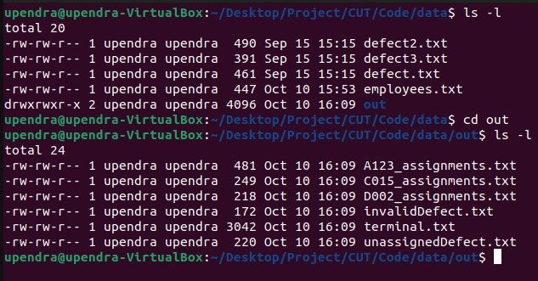
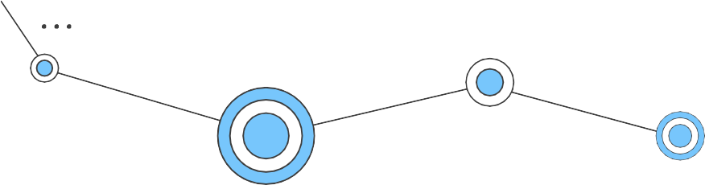
INTEGRATION TESTING FILES DIRECTORIES
Output Files
Input files
Input Files

Slide 27
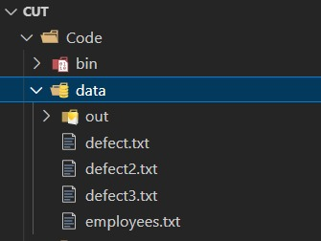
Integration Testing Output

Slide 28
INTEGRATION TESTING- TERMINAL OUTPUT
--- Searching Programmer for defect Id: F003 ---
--- Searching Programmer for defect Id: K002 ---
Defect Id: F003 Status: Assigned
Module Name: Aircraft design Functional Area: Manage customers
Description: Column values in client dashboard are not shown
Has been assigned to:- Employee Id: C015
Employee Name: Shreehari Khaire
Defect Id: K002 Status: Assigned
Module Name: reprehenderit Functional Area: BOM report
Description: sed quia non numquam eius modi tempora incidunt
Has been assigned to:- Employee Id: A123
Employee Name: Suresh Panchal
6
--- Searching Programmer for defect Id: K003 ---
--- Programmer not found for defect Id: K003 ---
1
--- Searching Programmer for defect Id: F003 ---
--- Searching Programmer for defect Id: K002 ---
Defect Id: F003 Status: Assigned
Module Name: Aircraft design Functional Area: Manage customers
Description: Column values in client dashboard are not shown
Has been assigned to:- Employee Id: C015
Employee Name: Shreehari Khaire
Defect Id: K002 Status: Assigned
Module Name: reprehenderit Functional Area: BOM report
Description: sed quia non numquam eius modi tempora incidunt
Has been assigned to:- Employee Id: A123
Employee Name: Suresh Panchal
6
--- Searching Programmer for defect Id: K003 ---
--- Programmer not found for defect Id: K003 ---
--- Total files in queue: 3 —
1
--- Searching Programmer for defect Id: F001 ---
--- Searching Programmer for defect Id: N004 ---
--- Total files in queue: 3 —
--- Searching Programmer for defect Id: F001 ---
--- Searching Programmer for defect Id: N004 ---
--- Total Employee: 7 ---
ID: A123 Name: Suresh Panchal ID: D012 Name: Karan Karan
ID: C015 Name: Shreehari Khaire ID: D002 Name: Mahesh Katkar
--- Total Employee: 7 ---
ID: A123 Name: Suresh Panchal ID: D012 Name: Karan Karan
ID: C015 Name: Shreehari Khaire ID: D002 Name: Mahesh Katkar
Defect Id: F001 Status: Assigned
Module Name: Aircraft design Functional Area: BOM report
Description: Column values in BOM reports are incorrect
2
Defect Id: F001 Status: Assigned
Module Name: Aircraft design Functional Area: BOM report
Description: Column values in BOM reports are incorrect
2
5
5
--- Creating Thread for file 1: /data/defect.txt ---
--- Creating Thread for file 2: /data/defect2.txt —
--- Processing file: ../data/defect.txt
--- Creating Thread for file 1: /data/defect.txt ---
--- Creating Thread for file 2: /data/defect2.txt —
--- Processing file: ../data/defect.txt
Has been assigned to:- Employee Id: A123
Employee Name: Suresh Panchal
--- Searching Programmer for defect Id: N001 --- Defect Id: N004
Status: Assigned
Module Name: Aircraft design Functional Area: BOM report
Description: BOM report columns not aligned properly
Has been assigned to:- Employee Id: A123
Employee Name: Suresh Panchal
Has been assigned to:- Employee Id: A123
Employee Name: Suresh Panchal
--- Searching Programmer for defect Id: N001 --- Defect Id: N004
Status: Assigned
Module Name: Aircraft design Functional Area: BOM report
Description: BOM report columns not aligned properly
Has been assigned to:- Employee Id: A123
Employee Name: Suresh Panchal
3
Defect ID: O001 contains insufficient information.
3
Defect ID: O001 contains insufficient information.
--- Creating Thread for file 3: /data/defect3.txt —
--- Processing file: ../data/defect2.txt Defect ID: M001 contains insufficient information.
--- Cannot open file: ../data/defect3.txt
--- Creating Thread for file 3: /data/defect3.txt —
--- Processing file: ../data/defect2.txt Defect ID: M001 contains insufficient information.
--- Cannot open file: ../data/defect3.txt
--- Total Valid Defects: 4 ---
--- Total Valid Defects: 4 ---
4
4
ID: F001 Status: open ID: F002 Status: close ID: N004 Status: open ID: K002 Status: open
ID: F001 Status: open ID: F002 Status: close ID: N004 Status: open ID: K002 Status: open
PTO
PTO
PTO
PTO

Slide 29




TEAM CAPG-84 GROUP 3
BHANU PRAKASH KORLEPARA
SANDHYA G
SUBHRANSU SAHU
SWETHA GANGA
UPENDRA GUPTA
VENKATA SATYA LAKSHMI DIVYA VARUPULA

Slide 30


